Slide 1
Analysis of pilot data
i.e. collected by Megan & Ivo

Slide 2
OUTSTANDING TO DO
Need to verify thtat the GLM betas for mine exactly match Megan’s. There is a discrep in p01 and p08. It may be that megan just made a mistake (the difference between her results and mine is v slight).
As long as I verify tt my data in subjdata matches the excel sheet (i.e. nothing sysmteatic tt goes wrong for everyone, i.e. p01 & p08 match as well as other subjects), that’ s okay.
Right now it’s mostly ok. Verify at some future point, but I assume that it is becaues Megan made a mistake

Slide 3
N trials

Slide 4
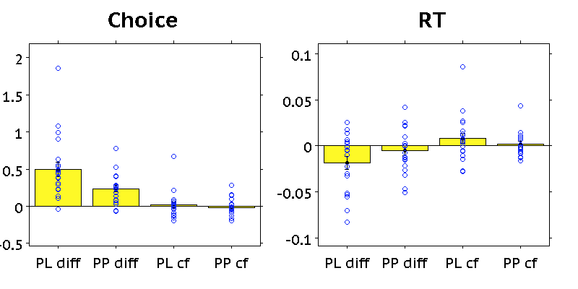
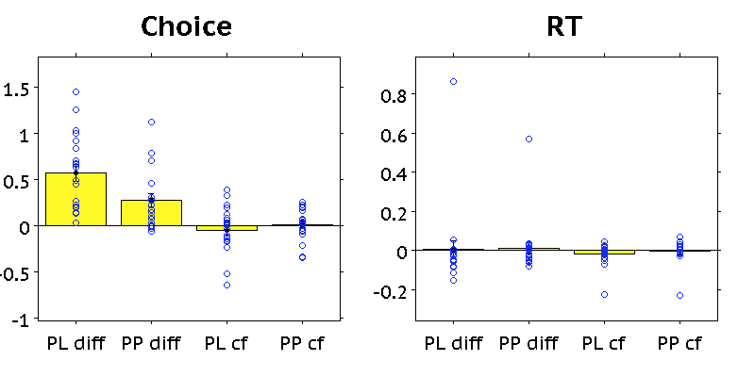
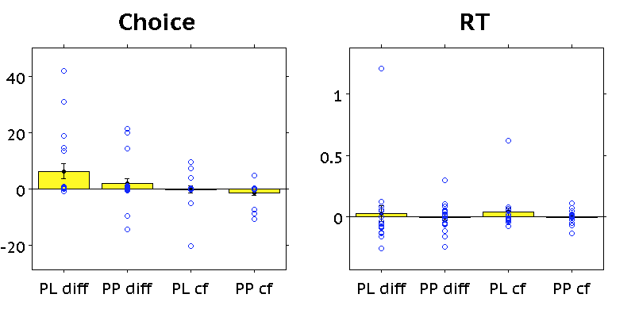
Regression analysis
P<.001
P=.013
P<.001
Compatible Choice trials
Incompatible Choice trials
P<.001
P=.030
P=.001
P=.093

Slide 5
See 2Nov2015 ABL presentation for more plots

